Slide 1
Basic Statistics
Source: http://www.statstutor.ac.uk/

Slide 2
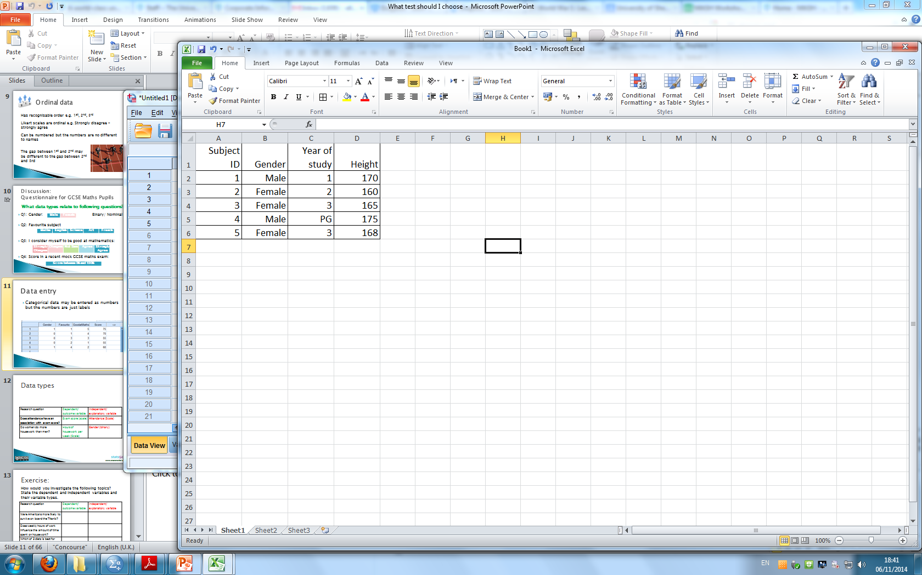
Data and variables
DATA: the answers to questions or measurements from the experiment
VARIABLE = measurement which varies between subjects e.g. height or gender
One variable per column
One row per subject
Notes:
For all types of quantitative data, it’s likely that it will end up in a spread sheet with individuals/ subjects on rows and each column representing a variable e.g. answer to Q1 from a questionnaire or heart beat after running for 5 mins. A variable is just a measurement which varies between subjects. The variable is usually the answer to questions or results of the experiment.

Slide 3
Data types
Data Variables
Scale
Measurements/ Numerical/ count data
Categorical:
appear as categories
Tick boxes on questionnaires
Notes:
What types of data are there? Within the data structure there are observations or individuals, and for each observation there are data variables. These variables can be classified into two main groups, Scale and categorical.
Categorical variables indicate categories and questions with categorical answers usually appear as tick boxes on questionaires. Scale variables are either measurements or counts.

Slide 4
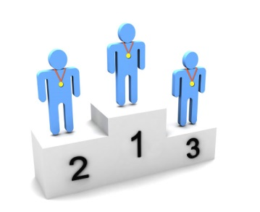

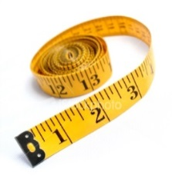

Data types
Variables
Scale
Categorical
Continuous
Measurements
takes any value
Discrete:
Counts/ integers
Ordinal:
obvious order
Nominal:
no meaningful order
Notes:
Categorical variables can be divided into two: ordinal and nominal. If the categories are meaningfully ordered, the variable is ordinal; if it doesn’t matter in which way the categories are ordered, then the variable is nominal. For example, satisfaction levels (dissatisfied, satisfied and highly satisfied) and education level (secondary, sixth form, undergraduate and postgraduate) are ordinal variables; Student’s religion (Christian, Muslim, Hindu, etc) and favourite animal are nominal variables.
Scale variables appear as meaningful comparable numbers, such as blood pressure, height, weight, income, age, and probability of illness etc. Numerical variables can be further divided into two subtypes: continuous and discrete. The continuous variables can take any value within a range and are the most common, e.g. body weight, height, income, etc. Discrete variables can only take whole numbers, such as number of students in class, number of new patients every day, etc but are treated as continuous for statistical analysis if there are a large range of numbers.
One point to make is that if ordinal data is scored as ranks such as 1, 2, 3 etc., and then this data is analysed as scale data, then a rather strong assumption is being made that the distances between the value of any pair of neighbouring ranks (e.g. 1 and 2 or 2 and 3 etc.) is the same, which is unlikely in practice to be true. Students often find the difference between ordinal and discrete difficult especially when ordinal is categorised as numbers
The point is that whilst this might not be the most interesting place to start – students need to be aware of the data they have since this affects what analyses are/not suitable.

Slide 5
Questionnaire for GCSE Maths Pupils
What data types relate to following questions?
Q1: What is your favourite subject?
Q2: Gender:
Q3: I consider myself to be good at mathematics:
Q4: Score in a recent mock GCSE maths exam:
Maths | English | Science | Art | French
Male | Female
Strongly Disagree | Disagree | Not Sure | Agree | Strongly Agree
Score between 0% and 100%
Notes:
Ask the audience what data types these are giving them time to think before going through the answers as a group.

Slide 6
Questionnaire for GCSE Maths Pupils
What data types relate to following questions?
Q1: What is your favourite subject?
Q2: Gender:
Q3: I consider myself to be good at mathematics:
Q4: Score in a recent mock GCSE maths exam:
Nominal
Maths | English | Science | Art | French
Male | Female
Binary/ Nominal
Strongly Disagree | Disagree | Not Sure | Agree | Strongly Agree
Ordinal
Score between 0% and 100%
Scale
Notes:
The answers. Point out that binary variables are a special case of nominal variables.
Ordinal variables are the one students get most confused about. Make it clear that although we usually number categorical variables in SPSS, this does not make them scale. The numbers are just labels. People come 1st, 2nd, 3rd etc in a race but the distance between 1st and 2nd may not be the same as the distance between 2nd and 3rd.

Slide 7
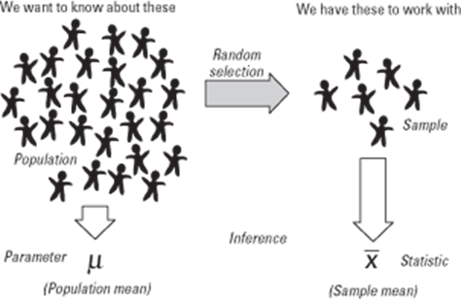
Populations and samples
Taking a sample from a population
Sample data ‘represents’ the whole population
Notes:
Inferential statistics centres around using a sample of subjects to represent a population. A population is the group of interest. A random selection from this population is called a sample. Statistics such as the mean and standard deviation are calculated using the sample data and used to estimate the population parameters.

Slide 8


Point estimation
Sample data is used to estimate parameters of a population
Statistics are calculated using sample data.
Parameters are the characteristics of population data
sample mean
Sample SD
Population mean
Population SD
$$\overline{x}$$
estimates
$$S$$
Notes:
We use x bar and s to represent the sample mean and standard deviation but we are really interested in the parameters of the population. The population parameters are represented by mu and sigma.

Slide 9
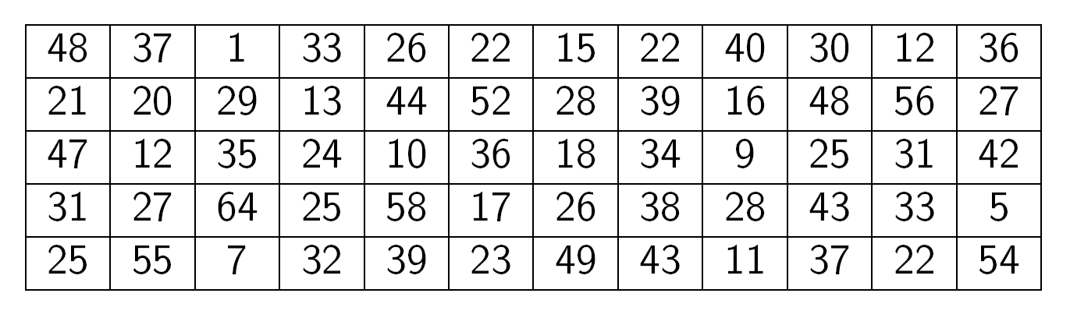
How can exam score data be summarised?
Exam marks for 60 students (marked out of 65)
mean = 30.3 sd = 14.46
Notes:
Student data on exam scores has been collected for a class of 60 students. How can this be summarised? Start by producing a histogram.

Slide 10
Summary statistics
Mean =
Standard deviation (s) is a measure of how much the individuals differ from the mean
Large SD = very spread out data
Small SD = there is little variation from the mean
For exam scores, mean = 30.5, SD = 14.46

Slide 11
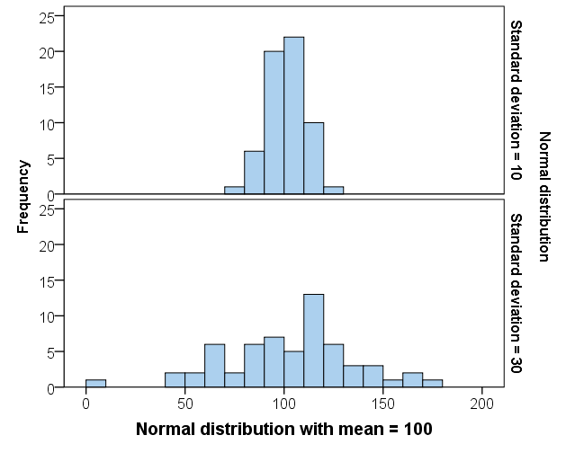
Interpretation of standard deviation
The larger the standard deviation, the more spread out the data is.
Notes:
For most students, the standard deviation is calculated using the computer so it is the interpretation that is most important. Showing them how standard deviation is a measure of spread using histograms is helpful.

Slide 12
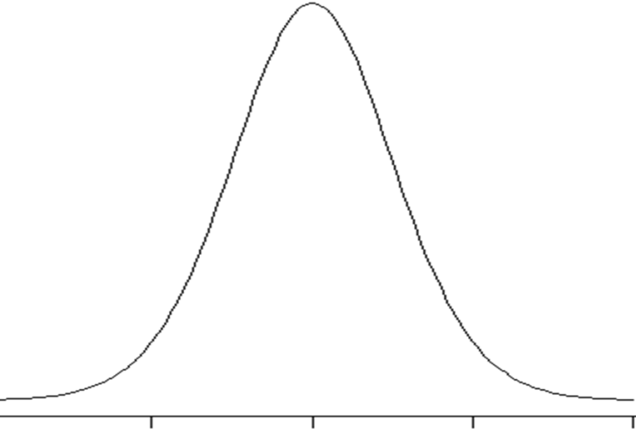
Scale data
To analyse it we often
If have scale data
Normal distribution
assume it follows a
ormal
Notes:
Most attending the workshop will be familiar with the normal distribution, but its important to highlight that this assumption is behind much of what students do when analysing scale data. But they might not have considered how to explain to a student in a maths support session what we mean by data being assumed to follow a normal distribution.
This slide and those that follow illustrate the steps taken to create a histogram and how this can be thought of as an empirical probability distribution and so how it can be used to assess whether it seems reasonable to assume that this empirical probability distribution comes from a normal distribution.

Slide 13
Discussion
How could you explain to a student what we mean by data being assumed to follow a Normal Distribution?
Notes:
Ask for the audience to offer their ideas before presenting the ideas contained on the following slides.

Slide 14
Group Frequency Table
 |  | Frequency | Percent
 | 0 but less than 10 | 4 | 6.7
 | 10 but less than 20 | 9 | 15.0
 | 20 but less than 30 | 17 | 28.3
 | 30 but less than 40 | 15 | 25.0
 | 40 but less than 50 | 9 | 15.0
 | 50 but less than 60 | 5 | 8.3
 | 60 or over | 1 | 1.7
 | Total | 60 | 100.0
Notes:
You could explain what the normal distribution is by building a histogram from data. Here the exam score data is used.
First build a frequency distribution by counting the number of students within each category.

Slide 15
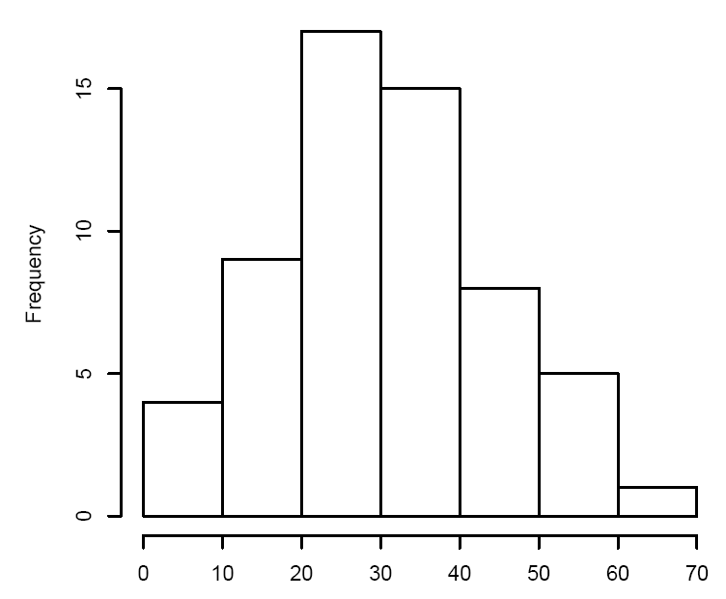
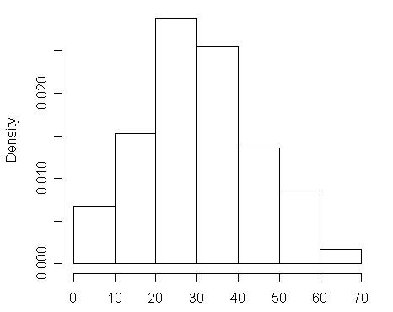
Histogram and Probability Distribution for Exam Marks Data
Notes:
Next use the frequencies to construct the histogram. This is called a frequency distribution. To get a probability distribution, divide each bar by the total number of students (60).

Slide 16
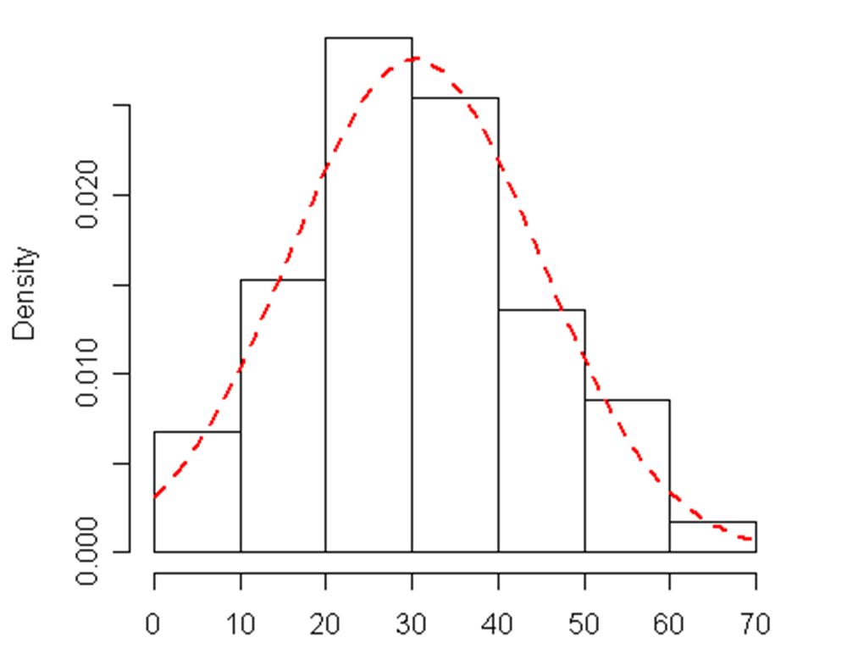
Histogram and Probability Distribution for Exam Marks Data
Notes:
A normal curve can be added which smoothes out the histogram. This can be used to estimate probabilities given the mean and standard deviation.

Slide 17
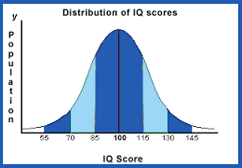
IQ is normally distributed
Above average
Average
Mensa
Mean = 100, SD = 15.3
Notes:
This is the probability distribution as a curve for IQ. The mean is 100 and the standard deviation shows the spread. For a perfect normal distribution, 50% of the population are above the mean and 50% are below. Most people are between 70 and 130 with a few above 145. The probability of randomly selecting a person from the population with an IQ above 145 is very small.

Slide 18
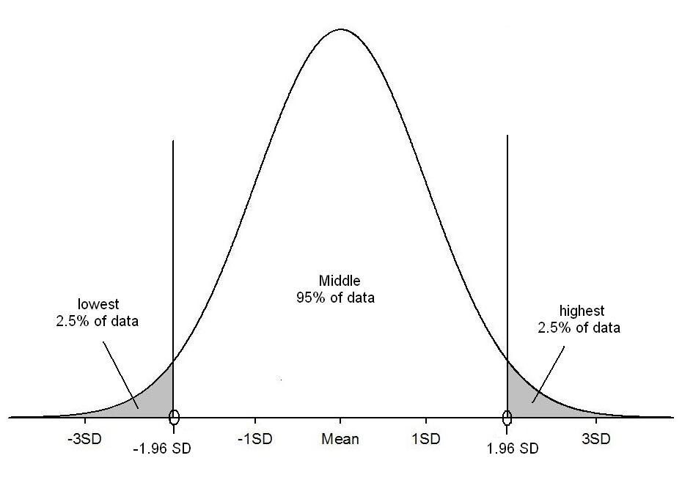
95% 1.96 x SD’s from the mean
95% of values
P(score > 130) = 0.025
100
130
70
95% of people have an IQ between 70 and 130
Notes:
Another important fact about normally distributed data is that 95% of the population lie between plus and minus 1.96*SD’s of the mean. For the IQ data this means that 95% of people have an IQ between 70 and 130 with only 2.5% above 130. This is important when understanding confidence intervals.

Slide 19
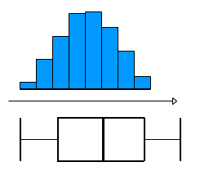
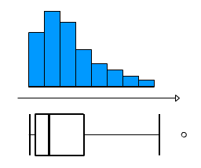
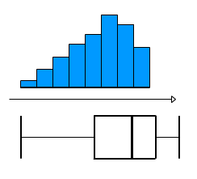
Assessing Normality
Charts can be used to informally assess whether data is:
Normally
distributed
Or….Skewed
The mean and median are very different for skewed data.
Notes:
normality is an important issue in statistics. This can be assessed graphically using a histogram or box-plot. The first pair show a perfect normal distribution. When assessing normality, we are only concerned with data that is very skewed as in the second and third pairs of graphs. Comparing means and medians can also help as the wider apart they are the more skewed the data is.

Slide 20
Discussion
Is the following statement:
“2 out of 3 people earn less than the average income”
True
False
Don’t know
Notes:
The aim of this question is to illustrate that there are several averages and that the median sometimes makes more sense.

Slide 21
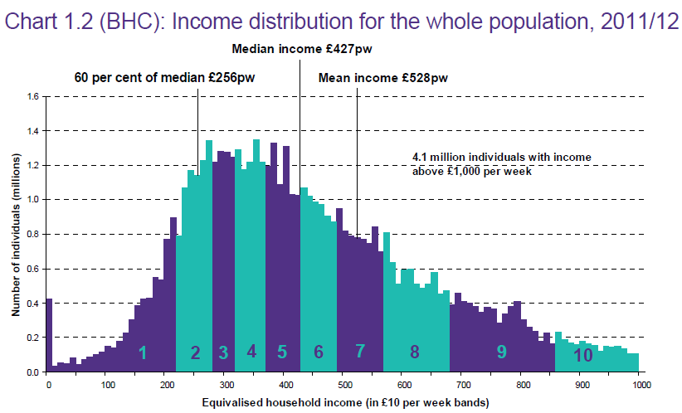
Sometimes the median makes more sense!
2/3rd people
50% people
Source: Households Below Average Income: An analysis of the income distribution1994/95 – 2011/12, Department for Work and Pensions
Notes:
Could also comment that for ordinal data the median also makes more sense irrespective of the distribution.

Slide 22
Choosing summary statistics
Which average and measure of spread?
Scale
Categorical
Normally distributed
Mean (Standard deviation)
Skewed data
Median (Interquartile range)
Ordinal:
Median
(Interquartile range)
Nominal:
Mode (None)
Notes:
The best average to use depends on the type of data. Only the mode can be used for nominal data although the mean of binary 0/ 1 data is the proportion coded as 1. For skewed and ordinal data, the median and interquartile range are preferable and for normally distributed data, the mean and standard deviation are used.

Slide 23
Which graph? Exercise
1st variable | Only 1 variable | Scale | Categorical
Scale | Histogram | Scatter plot | Box-plot/ Confidence interval plot
Categorical | Pie/ Bar | Box-plot/ Confidence interval plot | Stacked/ multiple bar chart
Which graph would you use when investigating:
Whether daily temperature and ice cream sales were related?
Comparison of mean reaction time for a group having alcohol and a group drinking water
Notes:
The right graph to use also depends on the type of variable. If there is just one scale variable, a histogram is best to show the spread of the data. For one categorical variable, a bar or pie chart can be used although a bar chart is better for ordinal data. For 2 categorical variables a stacked or multiple bar chart can be used and for two scale variables a scatterplot is preferable. When comparing scale measurements by group, a boxplot or confidence interval plot can be used. A box-plot shows the spread of individual scores whereas the confidence interval plot gives a range of values for the population mean of each group.
Student exercise: Think about which graph should be used in each of the two situations and interpret the summary statistics on the next slide.

Slide 24
Exercise: Ticket cost comparison
Summary statistics for cost of Titanic ticket by survival
Is there a big difference in average ticket price by group?
Which group has data which is more spread out?
Is the data skewed?
Is the mean or median a better summary measure?
Cost of ticket | Survived?
 | Died | Survived
Mean | 23.4 | 49.4
Median | 10.5 | 26
Standard Deviation | 34.2 | 68.7
Interquartile range | 18.2 | 46.6
Minimum | 0 | 0
Maximum | 263 | 512.33
www.statstutor.ac.uk
Notes:
Student exercise to work on in groups.

Slide 25
Which graph? Solution
1st variable | Only 1 variable | Scale | Categorical
Scale | Histogram | Scatter plot | Box-plot/ Confidence interval plot
Categorical | Pie/ Bar | Box-plot/ Confidence interval plot | Stacked/ multiple bar chart
Which graph would you use when investigating:
Whether daily temperature and ice cream sales were related? Scatter
Comparison of mean reaction time for a group having alcohol and a group drinking water Boxplot or confidence interval plot
Notes:
Use a scatterplot as both variables are scale
Use a boxplot or CI plot as reaction time is scale and the independent variable is categorical

Slide 26
Exercise: Ticket cost comparison Solution
Is there a big difference in average ticket price by group?
The mean and median are much bigger in those who survived.
Which group has data which is more spread out?
The standard deviation and interquartile range are much bigger for those who survived so that data is more spread out
Is the data skewed?
Yes. The medians are much smaller than the means and the plots show the data is positively skewed.
Is the mean or median a better summary measure?
The median as the data is skewed
www.statstutor.ac.uk
Notes:
Go through solution

Slide 27

Hypothesis testing
An objective method of making decisions or inferences from sample data (evidence)
Sample data used to choose between two choices i.e. hypotheses or statements about a population
We typically do this by comparing what we have observed to what we expected if one of the statements (Null Hypothesis) was true
Notes:
The cat is faced with a decision! To go out into the snow or not since it looks cold and wet. It has two hypotheses; Null: it won’t get its paws wet and be cold, Alternative: It will get its paws wet and will be cold. It could base it’s decision on data it collected in its mind in the past; when it went out in the snow in the past it’s paws did get cold and wet and so may make the decision not to go out based on that evidence! Hypothesis testing pervades all of our lives all of the time without us realising it. We make decisions based on evidence. Sometimes they are the right ones and sometimes they are wrong. There is a chance of getting it wrong, so we develop strategies for minimising these risks of getting it wrong – this is the basics of the framework for hypothesis testing!

Slide 28
Hypothesis testing Framework What the text books might say!
Always two hypotheses:
H_{A}: Research (Alternative) Hypothesis
What we aim to gather evidence of
Typically that there is a difference/effect/relationship etc.
H₀: Null Hypothesis
What we assume is true to begin with
Typically that there is no difference/effect/relationship etc.
Notes:
This is what the text books say but to many students this language can be very inaccessible!
28

Slide 29

Could try explaining things in the context of “The Court Case”?
Members of a jury have to decide whether a person is guilty or innocent based on evidence
Null: The person is innocent
Alternative: The person is not innocent (i.e. guilty)
The null can only be rejected if there is enough evidence to doubt it
i.e. the jury can only convict if there is beyond reasonable doubt for the null of innocence
They do not know whether the person is really guilty or innocent so they may make a mistake
Notes:
Ask what decisions are being made here and what errors could be made.

Slide 30
Types of Errors
Controlled via sample size (=1-Power of test)
Typically restrict to a 5% Risk
= level of significance
 | Study reports NO difference (Do not reject H₀) | Study reports IS a difference (Reject H₀)
H₀ is true Difference Does NOT exist in population
H_{A} is true Difference DOES exist in population
X
Type I Error
X
Type II Error
Prob of this = Power of test
Notes:
Before revealing all of this slide you could ask a few of the following questions:
What is the level of significance?
What is a Type I error? A Type II error?
What is a false positive?
What is statistical power?
You could you also ask how they would explain all of these things to a student?

Slide 31
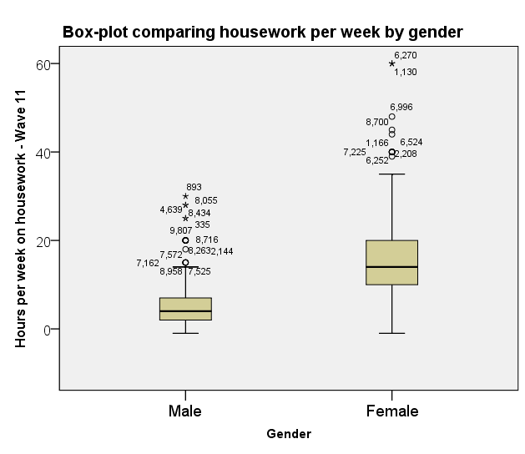
Summarising means
Calculate summary statistics by group
Look for outliers/ errors
Use a box-plot or confidence interval plot
www.statstutor.ac.uk
Notes:
Use this slide to point out that when comparing two groups with respect to their means, then box plots are useful as an exploratory tool to check for outliers.

Slide 32
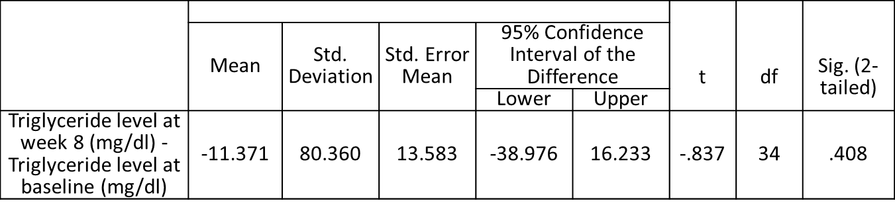
Confidence Intervals
A range of values within which we are confident (in terms of probability) that the true value of a pop parameter lies
A 95% CI is interpreted as 95% of the time the CI would contain the true value of the pop parameter
i.e. 5% of the time the CI would fail to contain the true value of the pop parameter
Notes:
Discuss the interpretation of the CI in the above and also comment on how this relates to the conclusion drawn from the earlier (equivalent) hypothesis test.

Slide 33
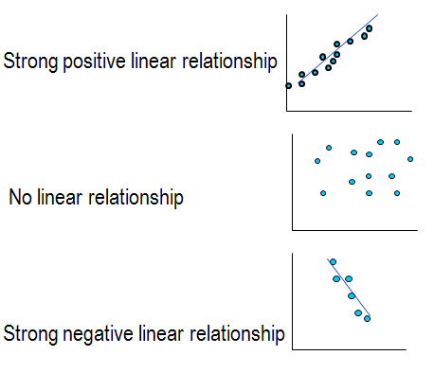
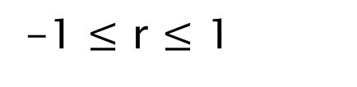
Correlation Coefficient r
Measures strength of a relationship between two continuous variables
-1 $≤$ r $≤$ 1
r = 0.9
r = 0.01
r = -0.9
www.statstutor.ac.uk
Notes:
Correlation quantifies this relationship. Correlation coefficients range from -1 and +1 with 0 meaning there is no relationship at all (see middle graph). The further away from 0 the coefficient is, the stronger the relationship. A positive number means that as x increases, so does y and negative coefficients that y decreases as x increases.
Here are some examples. The first shows strong positive correlation, the second no relationship and the 3rd a strong negative relationship.

Slide 34
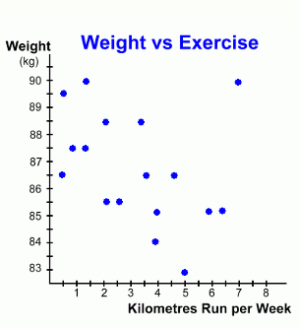
Scatterplot
Relationship between two scale variables:
Explores the way the two co-vary: (correlate)
Positive / negative
Linear / non-linear
Strong / weak
Presence of outliers
Statistic used:
r = correlation coefficient
Outlier
Linear
Notes:
The scatter graph or scatterplot is one of the most common graphs in statistics. It is used to explore the relationship between two scale variables. Here we see the relationship between how far a person runs each week and their weight. Each point represents a person.
Is there a linear or non-linear pattern?
Is the relationship positive or negative (is there an uphill or downhill slope)?
Is the relationship, strong (points close to the line) or weak (random scatter)?
A scatterplot will help answer these questions. It will also help detect any outliers, which do not follow the general trend. Here there is one outlier (someone who weighs a lot but also runs a lot)

